Slide 1
Angle Modulation
Prepared by
Rifat Rahman
Assistant Professor
Institute of Appropriate Technology, BUET
https://rrahman007.buet.ac.bd
and
Prof. Hitesh Dholakiya

Slide 2
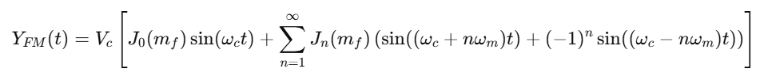

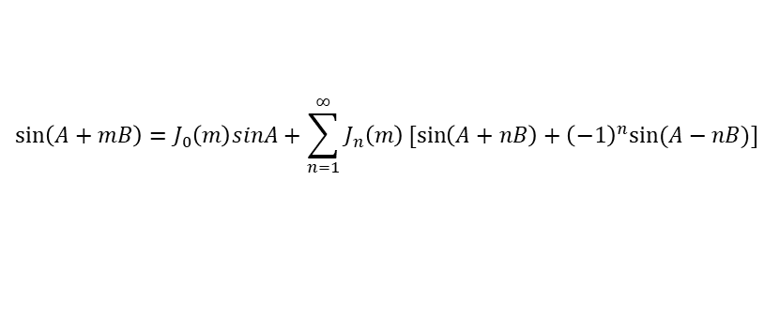
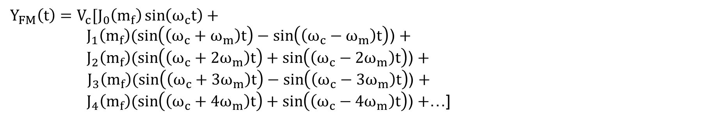
Spectral Components of Angle Modulation
Equation of Frequency Modulation {If the carrier signal is 𝐕_{𝐂} 𝐬𝐢𝐧 𝛚_{𝐜}𝐭 and the Message Signal is 𝐕_{𝐦} 𝐜𝐨𝐬 𝛚_{𝐦}𝐭 } is given by:
$Y_{FM}\left(t\right)=V_{c}sin⁡(ω_{c}t+m_{f}\sin\left(ω_{m}t\right))$ [Here, Modulation Index, $m_{f}=\frac{Δf}{f_{m}}]$
$$Y_{FM}\left(t\right)=V_{c}[J_{0}\left(m_{f}\right)\sin\left(ω_{c}t\right)+$$
$J_{1}\left(m_{f}\right)(\sin\left(\left(ω_{c}+ω_{m}\right)t\right)−\sin\left(\left(ω_{c}−ω_{m}\right)t\right)$) $+$
$J_{2}\left(m_{f}\right)(\sin\left(\left(ω_{c}+{2ω}_{m}\right)t\right)+\sin\left(\left(ω_{c}−{2ω}_{m}\right)t\right)$) $+$
${ J}_{3}\left(m_{f}\right)(\sin\left(\left(ω_{c}+{3ω}_{m}\right)t\right)−\sin\left(\left(ω_{c}−{3ω}_{m}\right)t\right)$) $+$
$J_{4}\left(m_{f}\right)(\sin\left(\left(ω_{c}+{4ω}_{m}\right)t\right)+\sin\left(\left(ω_{c}−{4ω}_{m}\right)t\right)$) $+$…]
$$\sin\left(A+mB\right)=J_{0}\left(m\right)sinA+\sum_{n=1}^{∞}{J_{n}\left(m\right)[sin\left(A+nB\right)+{\left(−1\right)}^{n}sin⁡(A−nB)]}$$
Here,$J_{0}\left(m_{f}\right), J_{1}\left(m_{f}\right), J_{2}(m_{f})$, ……… are Bessel Function and their value depends on Modulation Index.

Slide 3
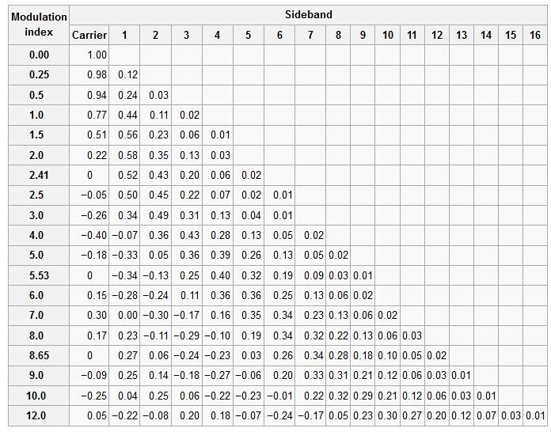
Bessel Function Table with respect to Modulation Index

Slide 4
Observation from Bassel Function Table
FM wave consists of the carrier {The first term in the equation}.
FM wave consists of an infinite number of sidebands.
The magnitude 𝐕_{𝐂}𝐉_{𝐧} of the carrier and sidebands depends on the Bessel Function.
Some Bessel Function can be negative. Therefore, there is a 180 degree phase shift for that given sidebands.
For Certain value of modulation index, the carrier component will disappear completely. These values are called eigen values.
For FM Signal, Transmitted power always remains constant. It is not dependent on modulation index.
_{𝐕𝐂}𝟐
⟹ 𝐏_{𝐭} = _{𝟐𝐑}

Slide 5
Bandwidth of FM wave
Theoretically, the bandwidth of the FM wave is Infinite. But, practically, it is calculated based on how many sidebands have significant amplitude. The Simplest method to calculate the bandwidth is as under:
⟹ 𝐁𝐖 = 𝟐𝐅_{𝐦} × 𝐍𝐮𝐦𝐛𝐞𝐫 𝐨𝐟 𝐒𝐢𝐠𝐧𝐢𝐟𝐢𝐜𝐚𝐧𝐭 𝐒𝐢𝐝𝐞𝐛𝐚𝐧𝐝𝐬
The second method is based on Carson’s Rule.
It States that the bandwidth of FM Wave is twice the sum of the deviation and highest modulating frequency.
⟹ 𝐁𝐖 = 𝟐 ∆𝐅 + 𝐅_{𝐦}
Carson’s Rule accommodates almost 98% of the Transmitted Power.
Parameters | DSB-FC | DSB-SC | SSB-SC | VSB
Bandwidth | 𝟐𝐅_{𝐦} | 𝟐𝐅_{𝐦} | 𝐅_{𝐦} | 𝐅_{𝐦} + 𝐅_{𝐕} 25% to 30% greater then SSB.
The Bandwidth of FM is greater than AM, but FM has better noise immunity.

Slide 6
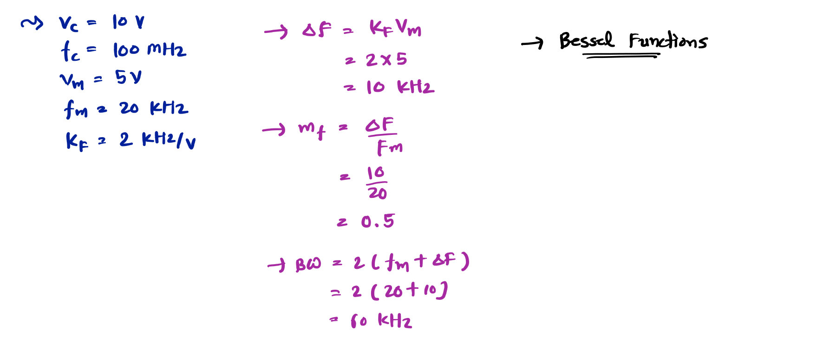
Example 1. A carrier wave of amplitude 10V and frequency 100 MHz is frequency modulated by a sinusoidal voltage. The modulating voltage has an amplitude of 5V and a frequency 𝐟_{𝐦} = 𝟐𝟎 𝐤𝐇𝐳. The frequency deviation constant is 2 kHz/Volt. Draw the frequency spectrum of FM wave.

Slide 7
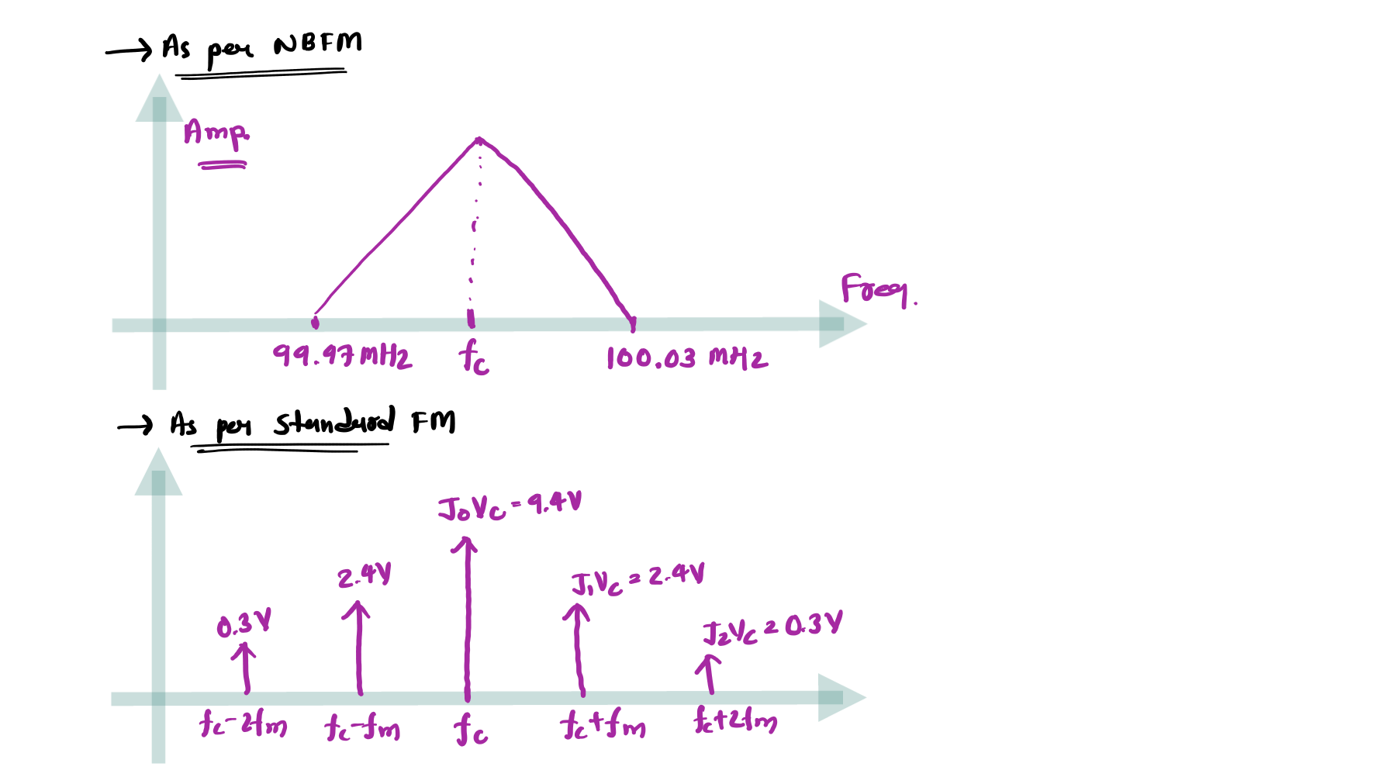

Slide 8

Bassel Function Table with respect to Modulation Index

Slide 9
Narrow Band Frequency Modulation (NBFM)
Outlines
Basics of NBFM
Derivation of the Equation of NBFM
Essential Keynotes of NBFM
NBFM Generation
Resolution of Issue in NBFM Generation

Slide 10








Basics of NBFM
NBFM is used to improve spectrum efficiency {Narrow Bandwidth}.
NBFM is used in Voice Communication and Radio Settings.
Modulation Index for NBFM is less than 1.
∆𝐅
Here, Modulation Index 𝐦 =
𝐟
𝐅_{𝐦}
Derivation of the Equation of NBFM
Equation of Frequency Modulation {If the carrier signal is 𝐕_{𝐂} 𝐜𝐨𝐬 𝛚_{𝐜}𝐭
Signal is 𝐕_{𝐦} 𝐜𝐨𝐬 𝛚_{𝐦}𝐭 } is given by:
and the Message
𝐤 𝐕
⟹ 𝐘_{𝐅𝐌} 𝐭 = 𝐕 𝐜𝐨𝐬
𝛚 𝐭 +
𝐟 𝐦
𝐬𝐢𝐧 𝛚 𝐭
𝐂 𝐜
𝐅_{𝐦}
𝐦
⟹ 𝐘_{𝐅𝐌}
⟹ 𝐘_{𝐅𝐌}
𝐭 = 𝐕_{𝐂} 𝐜𝐨𝐬 𝛚_{𝐜}𝐭 + 𝐦_{𝐟} 𝐬𝐢𝐧 𝛚_{𝐦}𝐭
𝐭 = 𝐕_{𝐂} 𝐜𝐨𝐬 𝛚_{𝐜}𝐭 𝐜𝐨𝐬 𝐦_{𝐟} 𝐬𝐢𝐧 𝛚_{𝐦}𝐭
− 𝐬𝐢𝐧 𝛚_{𝐜}𝐭 𝐬𝐢𝐧 𝐦_{𝐟} 𝐬𝐢𝐧 𝛚_{𝐦}𝐭
For Small values of Modulation Index, 𝐜𝐨𝐬 𝐦_{𝐟} 𝐬𝐢𝐧 𝛚_{𝐦}𝐭
= 𝟏, 𝐬𝐢𝐧 𝐦_{𝐟} 𝐬𝐢𝐧 𝛚_{𝐦}𝐭
= 𝐦_{𝐟} 𝐬𝐢𝐧 𝛚_{𝐦}𝐭
⟹ 𝐘_{𝐅𝐌}
⟹ 𝐘_{𝐅𝐌}
𝐭 = 𝐕_{𝐂} 𝐜𝐨𝐬 𝛚_{𝐜}𝐭 − 𝐦_{𝐟} 𝐬𝐢𝐧 𝛚_{𝐜}𝐭 𝐬𝐢𝐧 𝛚_{𝐦}𝐭
𝐭 = 𝐕_{𝐂} 𝐜𝐨𝐬 𝛚_{𝐜}𝐭 − 𝐕_{𝐂}𝐦_{𝐟} 𝐬𝐢𝐧 𝛚_{𝐜}𝐭 𝐬𝐢𝐧 𝛚_{𝐦}𝐭
𝐕 𝐦
𝐕 𝐦
⟹ 𝐘
𝐭 = 𝐕_{𝐂} 𝐜𝐨𝐬 𝛚_{𝐜}𝐭 +
𝐂 𝐟
𝟐
𝐜𝐨𝐬 𝛚 𝐭 + 𝛚
𝐭 −
𝐂 𝐟
𝟐
𝐜𝐨𝐬 𝛚 𝐭 − 𝛚 𝐭
𝐅𝐌
𝐜
𝐦
𝐜
𝐦
Carrier
USB
LSB

Slide 11




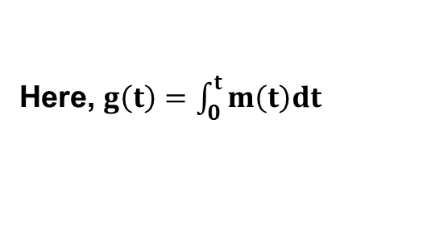
Essential Keynotes of NBFM
Equation of NBFM {If the carrier signal is 𝐕_{𝐂} 𝐜𝐨𝐬 𝛚_{𝐜}𝐭
𝐕_{𝐦} 𝐜𝐨𝐬 𝛚_{𝐦}𝐭 } is given by:
and the Message Signal is
𝐕 𝐦 𝐕 𝐦
⟹ 𝐘_{𝐅𝐌} 𝐭 = 𝐕 𝐜𝐨𝐬 𝛚 𝐭
+
𝐂 𝐟
𝟐
𝐜𝐨𝐬 𝛚 𝐭 + 𝛚
𝐭 −
𝐂 𝐟
𝟐
𝐜𝐨𝐬 𝛚 𝐭 − 𝛚 𝐭
𝐂 𝐜
𝐜 𝐦
𝐜
𝐦
Carrier
𝐭 = 𝐕_{𝐂} 𝐜𝐨𝐬 𝛚_{𝐜}𝐭
𝐭 = 𝐕_{𝐂} 𝐜𝐨𝐬 𝛚_{𝐜}𝐭
USB
− 𝐕_{𝐂}𝐦_{𝐟} 𝐬𝐢𝐧 𝛚_{𝐜}𝐭 𝐬𝐢𝐧 𝛚_{𝐦}𝐭
− 𝐕_{𝐂}𝐤_{𝐟}𝐠 𝐭 𝐬𝐢𝐧 𝛚_{𝐜}𝐭
LSB
⟹ 𝐘_{𝐅𝐌}
⟹ 𝐘_{𝐅𝐌}
Here, $g\left(t\right)=\int_{0}^{t}{m\left(t\right)dt}$
LSB is 𝟏𝟖𝟎^{𝟎} out of phase with respect to USB.
Modulation Index is less then 1 𝐦_{𝐟} < 𝟏 .
NBFM has only two side bands.
𝐕_{𝐂}𝐦_{𝐟}
Amplitude of the sidebands is .
𝟐
Frequency Deviation ΔF is limited in NBFM.
Modulation Index 𝐦
₌ 𝐤_{𝐟}𝐕_{𝐦 =} ∆𝐅
𝐟
𝐅_{𝐦} 𝐅_{𝐦}

Slide 12











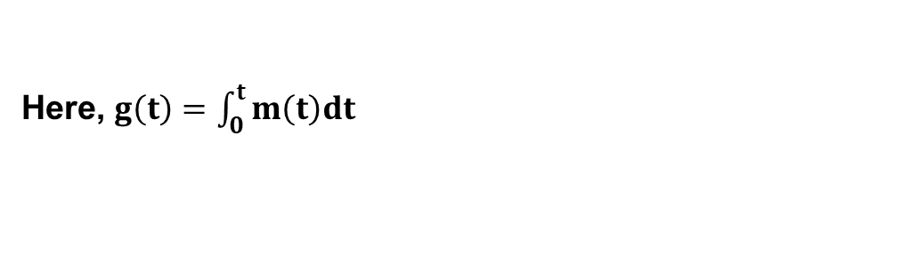
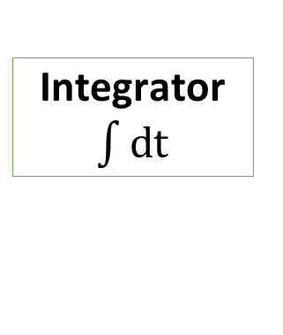
NBFM Generation
Equation of NBFM {If the carrier signal is 𝐕_{𝐂} 𝐜𝐨𝐬 𝛚_{𝐜}𝐭
𝐕_{𝐦} 𝐜𝐨𝐬 𝛚_{𝐦}𝐭 } is given by:
and the Message Signal is
⟹ 𝐘_{𝐅𝐌} 𝐭 =
𝐕_{𝐂} 𝐜𝐨𝐬 𝛚_{𝐜}𝐭
− 𝐕_{𝐂}𝐤_{𝐟}𝐠 𝐭 𝐬𝐢𝐧 𝛚_{𝐜}𝐭 Here, 𝐠 𝐭 = න 𝐦 𝐭 𝐝𝐭
Sidebands
Here, $g\left(t\right)=\int_{0}^{t}{m\left(t\right)dt}$
Carrier
−𝐕_{𝐂}𝐤_{𝐟}𝐠 𝐭 𝐬𝐢𝐧 𝛚_{𝐜}𝐭
𝐦 𝐭 Modulating Signal
Integrator
$\int{d}$t
DSB-SC Modulator
Adder
NBFM Signal
න 𝐦 𝐭 𝐝𝐭
−𝐕_{𝐂} 𝐬𝐢𝐧 𝛚_{𝐜}𝐭
𝛑/𝟐
Phase
Carrier Oscillator
𝐕_{𝐂} 𝐜𝐨𝐬 𝛚_{𝐜}𝐭

Slide 13


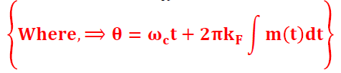








Resolution of Issue in NBFM Generation
Amplitude variation can occur due to the adder. A Bandpass Limiter can resolve that issue.
Hard Limiter
$$Y′(t)$$
BPF
$$V_{0}(θ)$$
NBFM Signal
Pure NBFM Signal
Hard Limiter converts NBFM Signal into a Square wave.
BPF will allow only 𝐜𝐨𝐬 𝛉 component.
So, Pure NBFM Signal will be given by:
𝟒
⟹ 𝐘_{𝐅𝐌} 𝐭 = _{𝛑} 𝐜𝐨𝐬 𝛉
𝐖𝐡𝐞𝐫𝐞, ⟹ 𝛉 = 𝛚_{𝐜}𝐭 + 𝟐𝛑𝐤_{𝐅} න 𝐦 𝐭 𝐝𝐭
The output of the Hard Limiter is given by:
$$V_{0}(θ)$$
+𝟏 𝐜𝐨𝐬 𝛉 > 0
−𝟏 𝐜𝐨𝐬 𝛉 < 0
⟹ 𝐘′ 𝐭 = ቊ
𝟒
𝛑
𝟏
𝟏
$$V_{0}(θ)$$
⟹ 𝐘′ 𝐭 =
𝐜𝐨𝐬 𝛉 − 𝐜𝐨𝐬 𝟑𝛉 + 𝐜𝐨𝐬 𝟓𝛉 − … … …
𝟑
𝟓

Slide 14
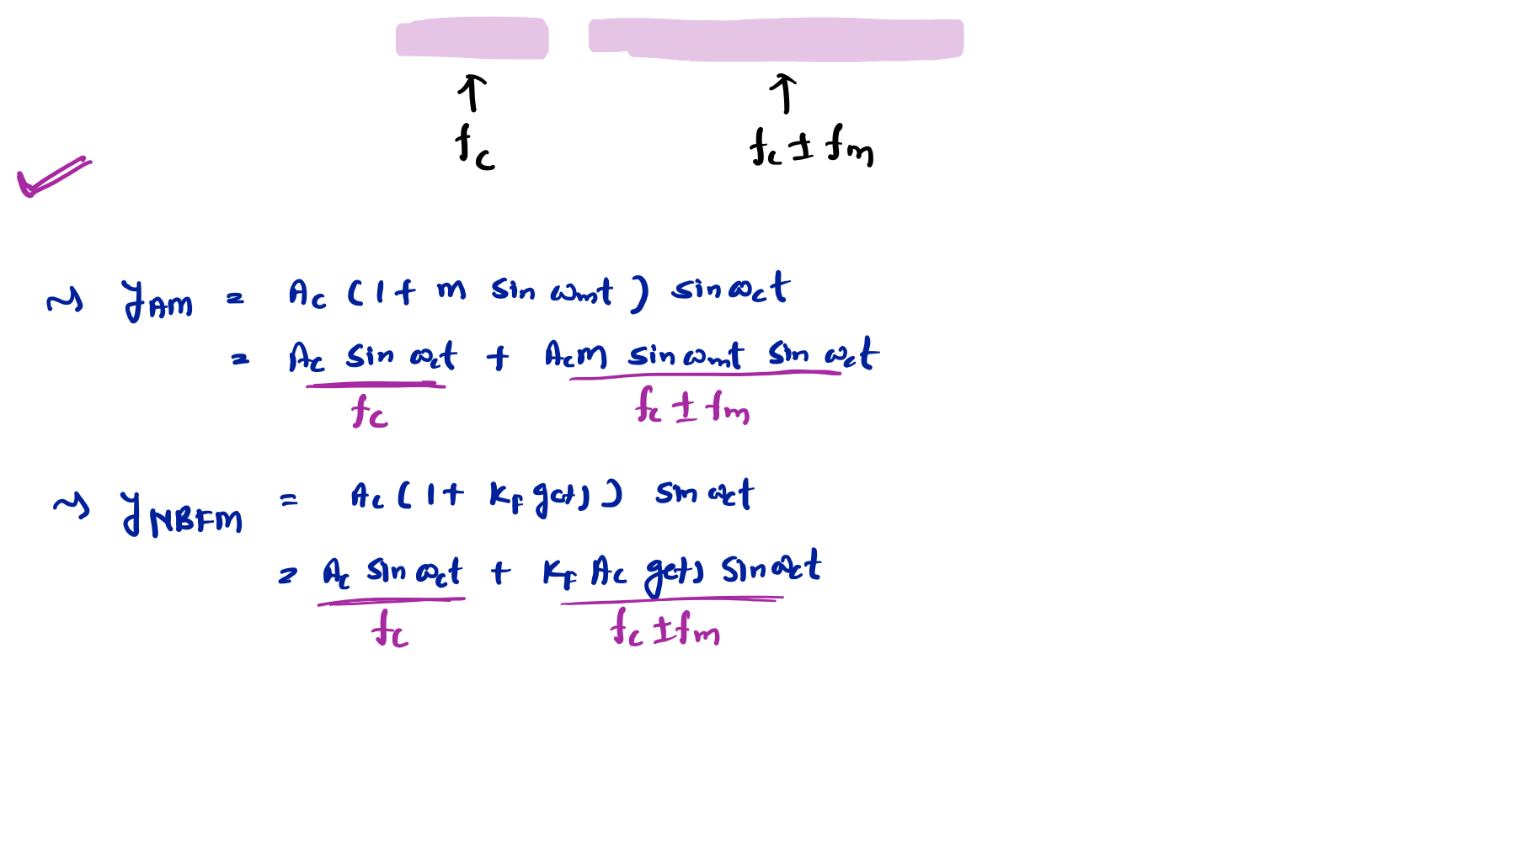
+ 𝟎. 𝟓 𝐜𝐨𝐬 𝛚_{𝐦}𝐭 𝐬𝐢𝐧 𝛚_{𝐜}𝐭 is ………………..
Example 2. The Signal 𝐜𝐨𝐬 𝛚_{𝐜}𝐭
FM only
AM only
Both AM and FM
Neither AM nor FM

Slide 15
Narrow Band Phase Modulation (NBPM)
Outlines
Basics of NBPM
Equation of NBPM
NBPM Generation
Resolution of Issue in NBPM Generation

Slide 16






Basics of NBPM
NBPM is used to improve spectrum efficiency {Narrow Bandwidth} {It is similar to NBFM}.
Modulation Index for NBPM is less than 1.
Here, Modulation Index 𝐦_{𝐏} = 𝐤_{𝐏}𝐕_{𝐦}
Derivation of the Equation of NBPM
Equation of Phase Modulation {If the carrier signal is 𝐂 𝐭 = 𝐕_{𝐂} 𝐜𝐨𝐬 𝛚_{𝐜}𝐭
Message Signal is 𝐦 𝐭 = 𝐕_{𝐦} 𝐜𝐨𝐬 𝛚_{𝐦}𝐭 } is given by:
and the
⟹ 𝐘_{𝐏𝐌}
⟹ 𝐘_{𝐏𝐌}
⟹ 𝐘_{𝐏𝐌}
𝐭 = 𝐕_{𝐂} 𝐜𝐨𝐬 𝛚_{𝐜}𝐭 + 𝐤_{𝐏}𝐦 𝐭
𝐭 = 𝐕_{𝐂} 𝐜𝐨𝐬 𝛚_{𝐜}𝐭 + 𝐦_{𝐏} 𝐜𝐨𝐬 𝛚_{𝐦}𝐭
𝐭 = 𝐕_{𝐂} 𝐜𝐨𝐬 𝛚_{𝐜}𝐭 𝐜𝐨𝐬 𝐦_{𝐏} 𝐜𝐨𝐬 𝛚_{𝐦}𝐭
− 𝐬𝐢𝐧 𝛚_{𝐜}𝐭 𝐬𝐢𝐧 𝐦_{𝐏} 𝐜𝐨𝐬 𝛚_{𝐦}𝐭
For Small values of Modulation Index, 𝐜𝐨𝐬 𝐦_{𝐏} 𝐜𝐨𝐬 𝛚_{𝐦}𝐭
⟹ 𝐘_{𝐏𝐌} 𝐭 = 𝐕_{𝐂} 𝐜𝐨𝐬 𝛚_{𝐜}𝐭 − 𝐦_{𝐏} 𝐬𝐢𝐧 𝛚_{𝐜}𝐭 𝐜𝐨𝐬 𝛚_{𝐦}𝐭
= 𝟏, 𝐬𝐢𝐧 𝐦_{𝐏} 𝐜𝐨𝐬 𝛚_{𝐦}𝐭
= 𝐦_{𝐏} 𝐜𝐨𝐬 𝛚_{𝐦}𝐭
⟹ 𝐘_{𝐏𝐌} 𝐭 =
𝐕_{𝐂} 𝐜𝐨𝐬 𝛚_{𝐜}𝐭
−
𝐕_{𝐂}𝐤_{𝐏}𝐦 𝐭 𝐬𝐢𝐧 𝛚_{𝐜}𝐭
Carrier
Sidebands

Slide 17






NBPM Generation
Equation of NBPM {If the carrier signal is 𝐕_{𝐂} 𝐜𝐨𝐬 𝛚_{𝐜}𝐭
𝐕_{𝐦} 𝐜𝐨𝐬 𝛚_{𝐦}𝐭 } is given by:
and the Message Signal is
⟹ 𝐘_{𝐏𝐌} 𝐭 =
𝐕_{𝐂} 𝐜𝐨𝐬 𝛚_{𝐜}𝐭
−
𝐕_{𝐂}𝐤_{𝐏}𝐦 𝐭 𝐬𝐢𝐧 𝛚_{𝐜}𝐭
Carrier
Sidebands
−𝐕_{𝐂}𝐤_{𝐩}𝐦 𝐭 𝐬𝐢𝐧 𝛚_{𝐜}𝐭
𝐦 𝐭 Modulating Signal
DSB-SC Modulator
Adder
NBPM Signal
−𝐕_{𝐂} 𝐬𝐢𝐧 𝛚_{𝐜}𝐭
𝛑/𝟐
Phase
Carrier
Oscillator
𝐕_{𝐂} 𝐜𝐨𝐬 𝛚_{𝐜}𝐭

Slide 18








Resolution of Issue in NBPM Generation
Amplitude variation can occur due to the adder. A Bandpass Limiter can resolve that issue.
Hard Limiter
$$Y′(t)$$
BPF
$$V_{0}(θ)$$
NBPM Signal
Pure NBPM Signal
Hard Limiter converts NBPM Signal into a Square wave.
BPF will allow only 𝐜𝐨𝐬 𝛉 component.
So, Pure NBPM Signal will be given by:
𝟒
⟹ 𝐘_{𝐏𝐌} 𝐭 = _{𝛑} 𝐜𝐨𝐬 𝛉
𝐖𝐡𝐞𝐫𝐞, ⟹ 𝛉 = 𝛚_{𝐜}𝐭 + 𝐤_{𝐏}𝐦 𝐭
The output of the Hard Limiter is given by:
$$V_{0}(θ)$$
+𝟏 𝐜𝐨𝐬 𝛉 > 0
−𝟏 𝐜𝐨𝐬 𝛉 < 0
⟹ 𝐘′ 𝐭 = ቊ
𝟒 𝟏 𝟏
⟹ 𝐘′ 𝐭 = _{𝛑} 𝐜𝐨𝐬 𝛉 − _{𝟑} 𝐜𝐨𝐬 𝟑𝛉 + _{𝟓} 𝐜𝐨𝐬 𝟓𝛉 − … … …
$$V_{0}(θ)$$

Slide 19
Wide Band Frequency Modulation (WBFM)
Outlines
Basics of WBFM
Bessel Function Table with respect to Modulation Index
WBFM Generation
Applications of WBFM

Slide 20
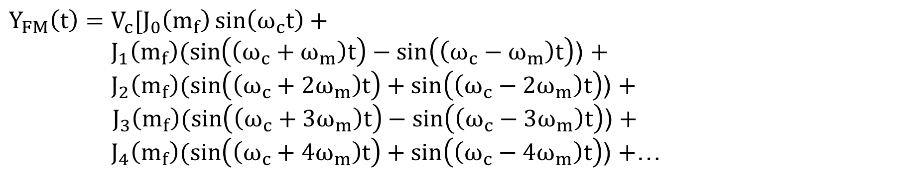
Basics of WBFM
Modulation Index 𝐦_{𝐟} for WBFM is Greater than 1.
∆𝐅
Here, Modulation Index 𝐦 =
𝐟
𝐅
𝐦
The bandwidth of WBFM is several times the message Bandwidth.
Equation of Frequency Modulation {If the carrier signal is 𝐕_{𝐂} 𝐬𝐢𝐧 𝛚_{𝐜}𝐭
Signal is 𝐕_{𝐦} 𝐜𝐨𝐬 𝛚_{𝐦}𝐭 } is given by:
and the Message
$Y_{FM}\left(t\right)=V_{c}sin⁡(ω_{c}t+m_{f}\sin\left(ω_{m}t\right))$ [Here, Modulation Index, $m_{f}=\frac{Δf}{f_{m}}]$
$$Y_{FM}\left(t\right)=V_{c}[J_{0}\left(m_{f}\right)\sin\left(ω_{c}t\right)+$$
$J_{1}\left(m_{f}\right)(\sin\left(\left(ω_{c}+ω_{m}\right)t\right)−\sin\left(\left(ω_{c}−ω_{m}\right)t\right)$) $+$
$J_{2}\left(m_{f}\right)(\sin\left(\left(ω_{c}+{2ω}_{m}\right)t\right)+\sin\left(\left(ω_{c}−{2ω}_{m}\right)t\right)$) $+$
${ J}_{3}\left(m_{f}\right)(\sin\left(\left(ω_{c}+{3ω}_{m}\right)t\right)−\sin\left(\left(ω_{c}−{3ω}_{m}\right)t\right)$) $+$
$J_{4}\left(m_{f}\right)(\sin\left(\left(ω_{c}+{4ω}_{m}\right)t\right)+\sin\left(\left(ω_{c}−{4ω}_{m}\right)t\right)$) $+$…
In WBFM, as Modulation Index is greater then 1, Bassel Function 𝐉_{𝐧} has more elements.

Slide 21
Bassel Function Table with respect to Modulation Index

Slide 22



WBFM Generation
1. Direct Method
𝐦 𝐭 Modulating Signal
VCO
WBFM
Signal
VCO Produce Output whose frequency is proportional to input message signal 𝐦 𝐭 .
⟹ 𝐟_{𝐨} = 𝐟_{𝐜} + 𝐤_{𝐅}𝐦 𝐭
2. Indirect Method
𝐦 𝐭 Modulating Signal
NBFM
Modulator
NBFM
Signal
Frequency Multiplier
WBFM
Signal
𝐕_{𝐂} 𝐜𝐨𝐬 𝛚_{𝐜}𝐭
Frequency Multiplier produces signal whose frequency is n times of input frequency.

Slide 23
Applications of WBFM
WBFM is widely used in FM Radio Broadcast {88 MHz to 108 MHz}.
FM Frequency Deviation is 75 KHz, for a 15 kHz Audio Band, there are 5 Bands.
WBFM is used in a High-Fidelity Audio System.
WBFM is used in Satellite Communication.
WBFM is also used in Telemetry, which has a large data range.

Slide 24







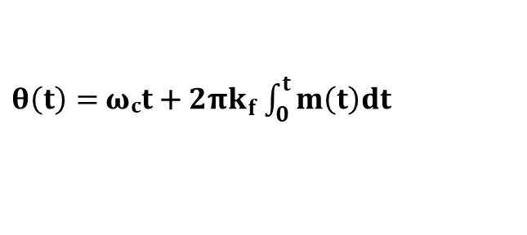

FM Generation by Direct Method
Basics of FM Signal
In Frequency Modulation, the Frequency of the Carrier Signal changes with respect to the Modulating Signal.
Let the Carrier Signal is given by:  Then, the Frequency Modulated Signal is given by:
⟹ 𝐂 𝐭 = 𝐕_{𝐂} 𝐜𝐨𝐬 𝛚_{𝐜}𝐭 ⟹ 𝐘_{𝐅𝐌} 𝐭 = 𝐕_{𝐂} 𝐜𝐨𝐬 𝛚 𝐭 𝐭 = 𝐕_{𝐂} 𝐜𝐨𝐬 𝛉 𝐭
Here, 𝛚 𝐭 and 𝛉 𝐭 is a function of the Message Signal 𝐦 𝐭 .
Frequency Modulation is a part of the Angle Modulation, The Angle of Frequency
Modulation is given by:
$θ\left(t\right)=$𝛚_{𝐜}𝐭 + $2πk_{f}\int_{0}^{t}{m\left(t\right)dt}$
The Frequency is given by:
⟹ 𝛚 𝐭 = 𝛚_{𝐜} + $2πk_{f}m(t)$
𝐤_{𝐅} is frequency Sensitivity, Unit is Hz/Volt.

Slide 25















Direct Method for FM Generation
Using Voltage Controlled Oscillator (VCO), The frequency of Carrier signal can be
controlled by an external voltage (Message Signal).
Heartily or Colpitts Oscillator
Schmitt Trigger Circuit
Saturable Core Reactor
d
N
Message Signal
𝐦 𝐭
P
Depletion
𝐋
𝐂_{𝟎}
Region
𝐀
⟹ 𝐂′ = 𝛆_{𝟎}𝛆_{𝐫 𝐝}
⟹ 𝐂′ = −𝐤𝐦 𝐭
Tank Circuit
Variable Reactor
Effective Capacitance:
⟹ 𝐂 = 𝐂_{𝟎} + 𝐂′ = 𝐂_{𝟎} − 𝐤𝐦 𝐭

Slide 26
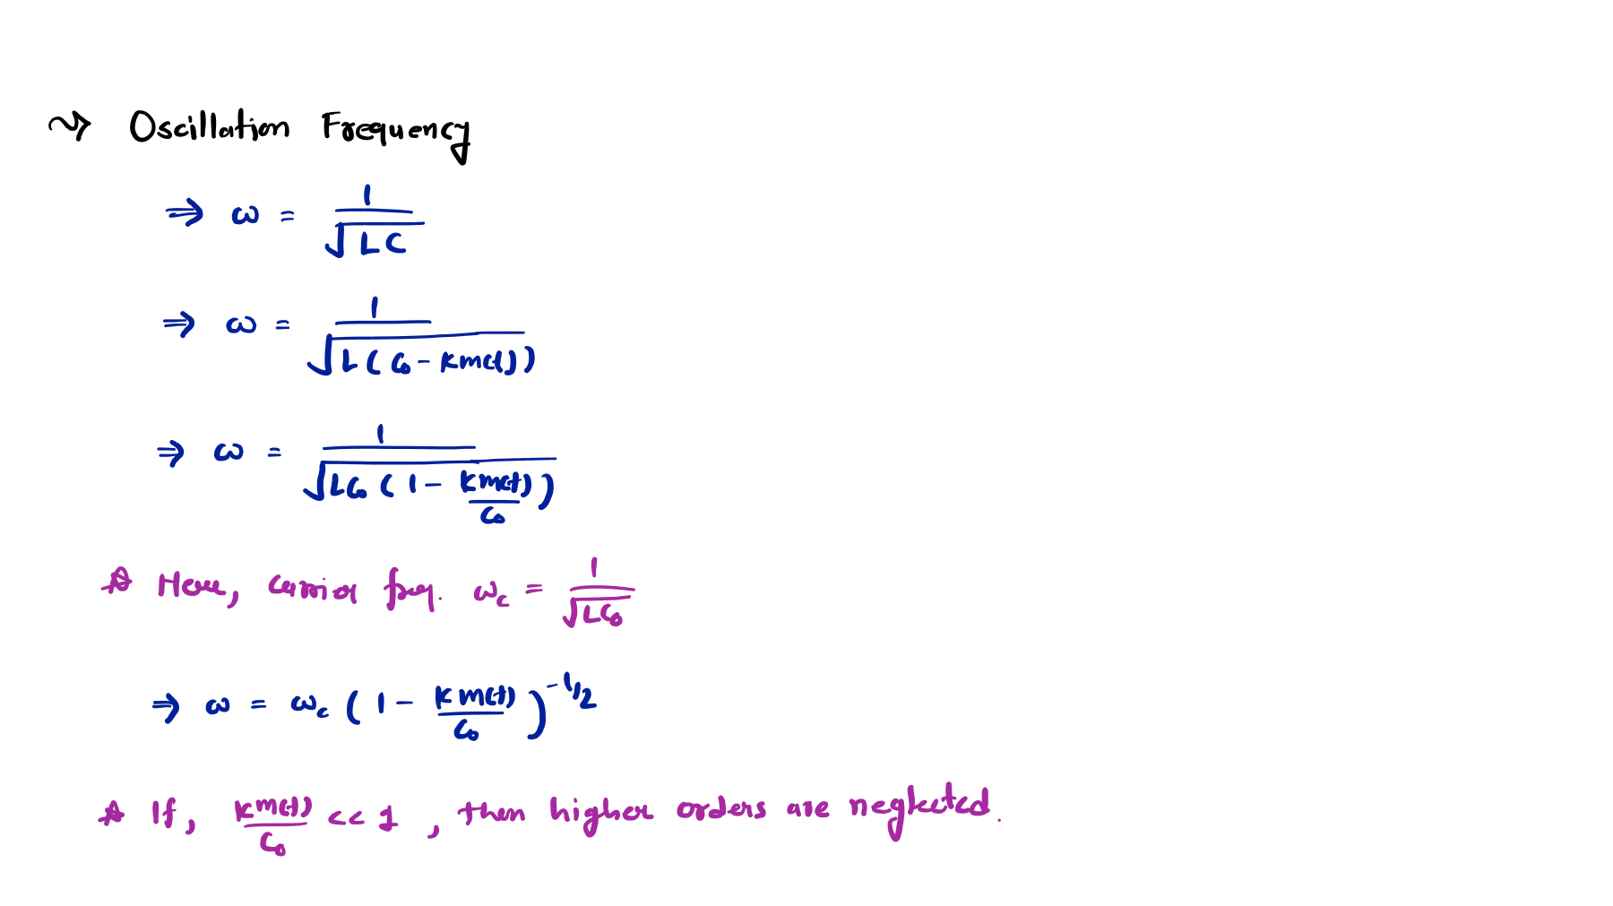
Derivation of FM Signal using Direct Method for FM Generation
Higher orders of the Taylor’s series will be neglected

Slide 27
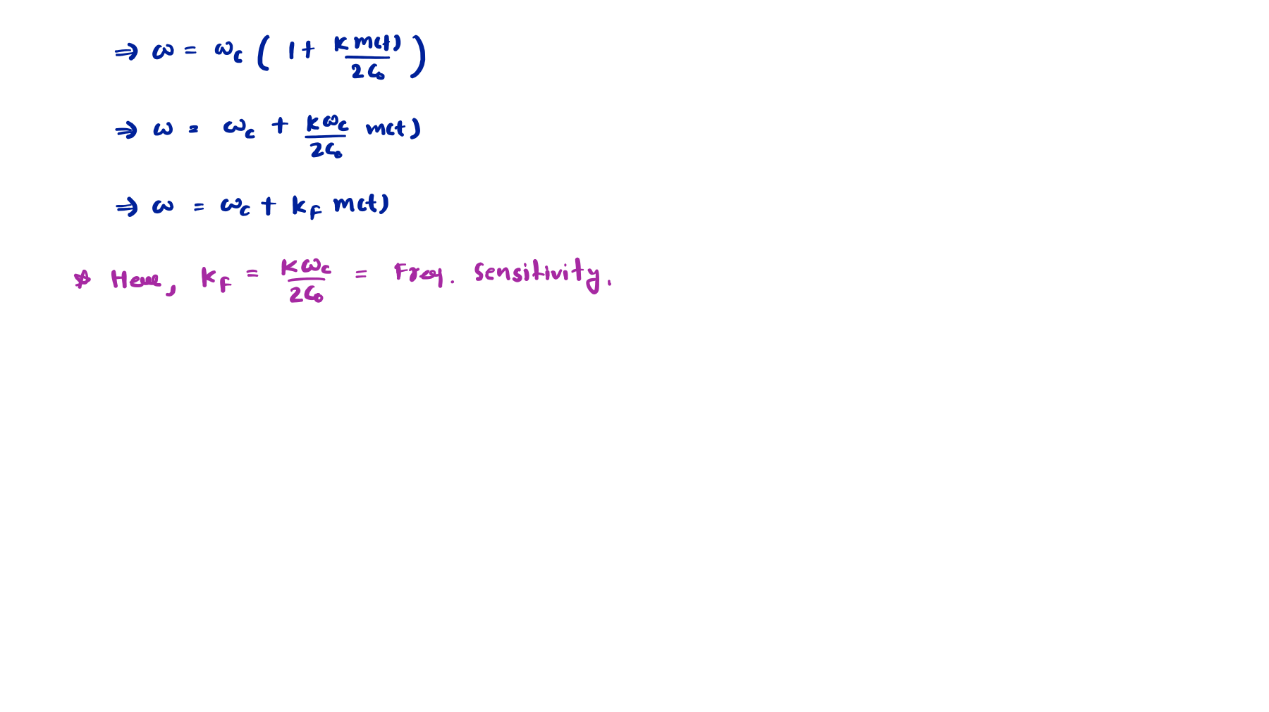
Advantages of Direct Method for FM Generation
It generates sufficient frequency deviation.
It requires little frequency multiplication.
Disadvantages of Direct Method for FM Generation
It has Poor Frequency Stability.

Slide 28
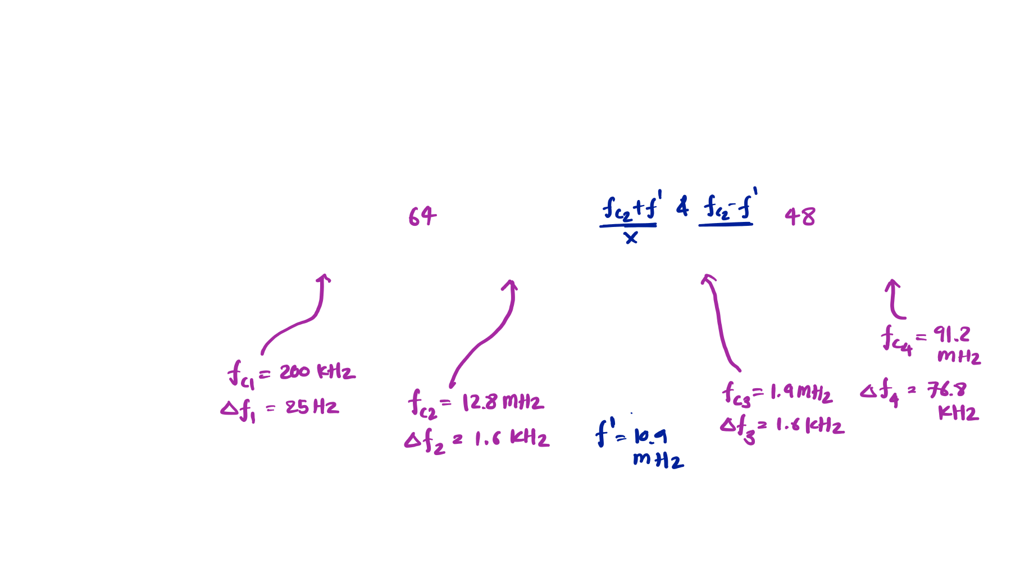

FM Generation by Indirect Method of Armstrong
Block Diagram of FM Generation by Indirect Method of Armstrong
𝐦 𝐭 Modulating Signal
NBFM
Frequency Multiplier
Frequency Conversion
Frequency Multiplier
FM
Signal
Crystal
Oscillator

Slide 29
NBFM Generation
Equation of NBFM {If the carrier signal is 𝐕_{𝐂} 𝐜𝐨𝐬 𝛚_{𝐜}𝐭
𝐕_{𝐦} 𝐜𝐨𝐬 𝛚_{𝐦}𝐭 } is given by:
and the Message Signal is
⟹ 𝐘_{𝐅𝐌} 𝐭 =
𝐕_{𝐂} 𝐜𝐨𝐬 𝛚_{𝐜}𝐭
− 𝐕_{𝐂}𝐤_{𝐟}𝐠 𝐭 𝐬𝐢𝐧 𝛚_{𝐜}𝐭 Here, 𝐠 𝐭 = න 𝐦 𝐭 𝐝𝐭
Sidebands
Here, $g\left(t\right)=\int_{0}^{t}{m\left(t\right)dt}$
Carrier
−𝐕_{𝐂}𝐤_{𝐟}𝐠 𝐭 𝐬𝐢𝐧 𝛚_{𝐜}𝐭
𝐦 𝐭 Modulating Signal
Integrator
$\int{d}$t
DSB-SC Modulator
Adder
NBFM Signal
න 𝐦 𝐭 𝐝𝐭
−𝐕_{𝐂} 𝐬𝐢𝐧 𝛚_{𝐜}𝐭
𝛑/𝟐
Phase
Carrier Oscillator
𝐕_{𝐂} 𝐜𝐨𝐬 𝛚_{𝐜}𝐭

Slide 30
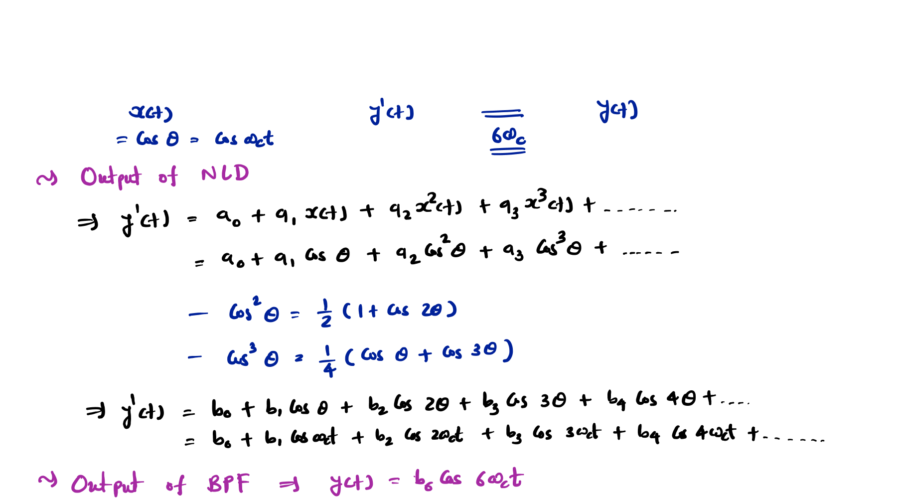
Frequency Multiplier
NLD
BPF

Slide 31
FM Demodulation
Outlines
FM Demodulation using Envelope Detector
Waveforms of FM Demodulation using Envelope Detector

Slide 32
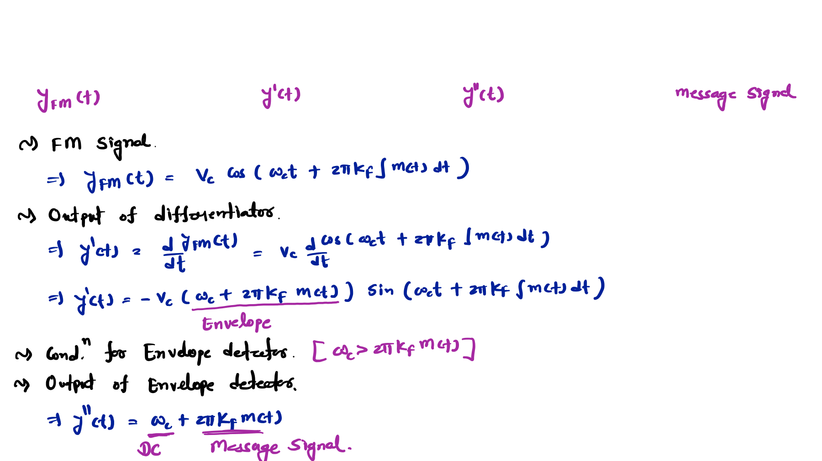

FM Demodulation using Envelope Detector
Differentiator
Envelope
Detector
HPF

Slide 33





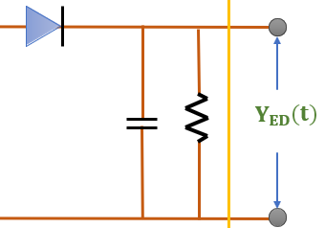












Circuit Diagram
Differentiator
Envelope
Detector
HPF
^{𝐘}𝐅𝐌
𝐭
^{𝛟}F𝐌
𝐭
^{𝐘}𝐄𝐃
𝐭
𝐦 𝐭
The Transfer Function of Differentiator 𝐇 𝐟 is directly Propositional to Frequency F.
⟹ 𝐇 𝐟 ∝ 𝐟
The Differentiator could be designed using High Pass Filter HPF.
𝐂
^{𝐘}𝐅𝐌
𝐭
𝐑
^{𝛟}F𝐌
𝐭
The Transfer Function is given by:
If 𝛚𝐑𝐂 ≪ 𝟏, then
⟹ 𝐇 𝐟 = 𝐣𝛚𝐂𝐑
⟹ 𝐇 𝐟 ∝ 𝐟
^{𝛟}𝐅𝐌
⟹ 𝐇 𝐟 =
𝐟 𝐑 𝐣𝛚𝐂𝐑
= =
_{𝐑 +} 𝟏
^{𝐘}F𝐌
𝐟 𝟏 + 𝐣𝛚𝐂𝐑
Here, The differentiator ^{𝐝𝐘𝐅𝐌} = Slope
𝐣𝛚𝐂
𝐝𝐭

Slide 34
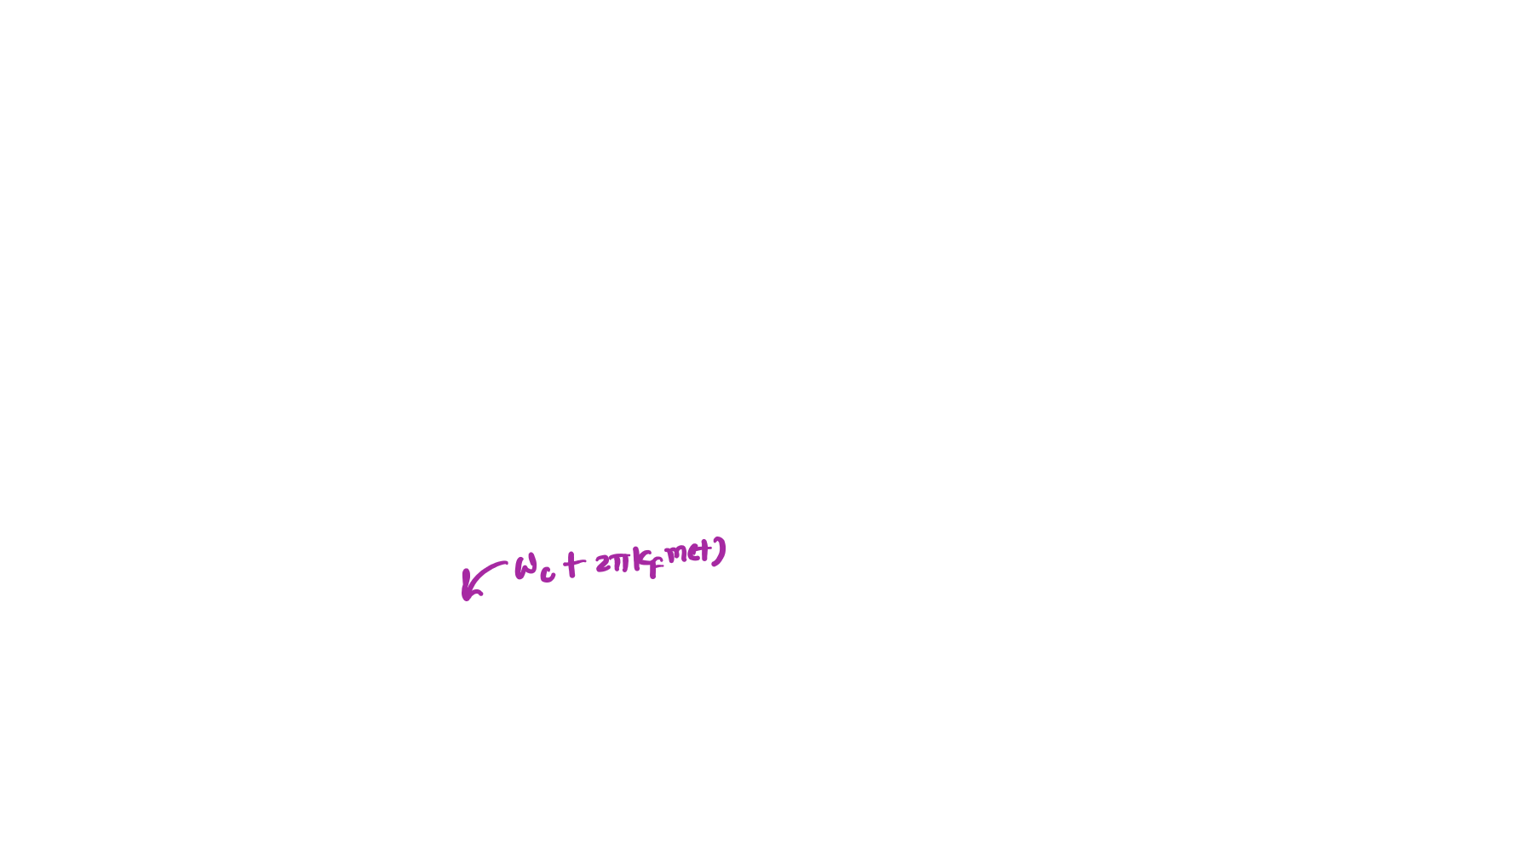



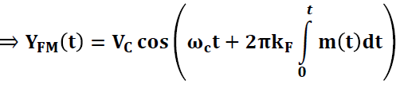



Waveforms of FM Demodulation using Envelope Detector
Amplitude Message Signal 𝐱 𝐭
Time t (Sec)
FM Signal 𝐘_{𝐅𝐌} 𝐭
Amplitude
𝐕_{𝐂}
𝒕
𝛚_{𝐜}𝐭 + 𝟐𝛑𝐤_{𝐅} න 𝐦 𝐭 𝐝𝐭
𝟎
⟹ 𝐘_{𝐅𝐌}
𝐭 = 𝐕_{𝐂} 𝐜𝐨𝐬
Time t (Sec)
−𝐕_{𝐂}
Amplitude
Envelope Signal 𝐲′ 𝐭
Time t (Sec)

Slide 35


FM Demodulation by Phase Lock Loop
Block Diagram of Phase Lock Loop
𝐞 𝐭
Loop Filter
𝐯 𝐭
FM wave
𝐒 𝐭
𝐫 𝐭
VCO
The Phase Lock Loop has three essential elements with Negative feedback:
Multiplier: It is used as a Phase Detector.
VCO: It works as a Local Oscillator.
Loop Filter: It acts as a Low Pass Filter.

Slide 36
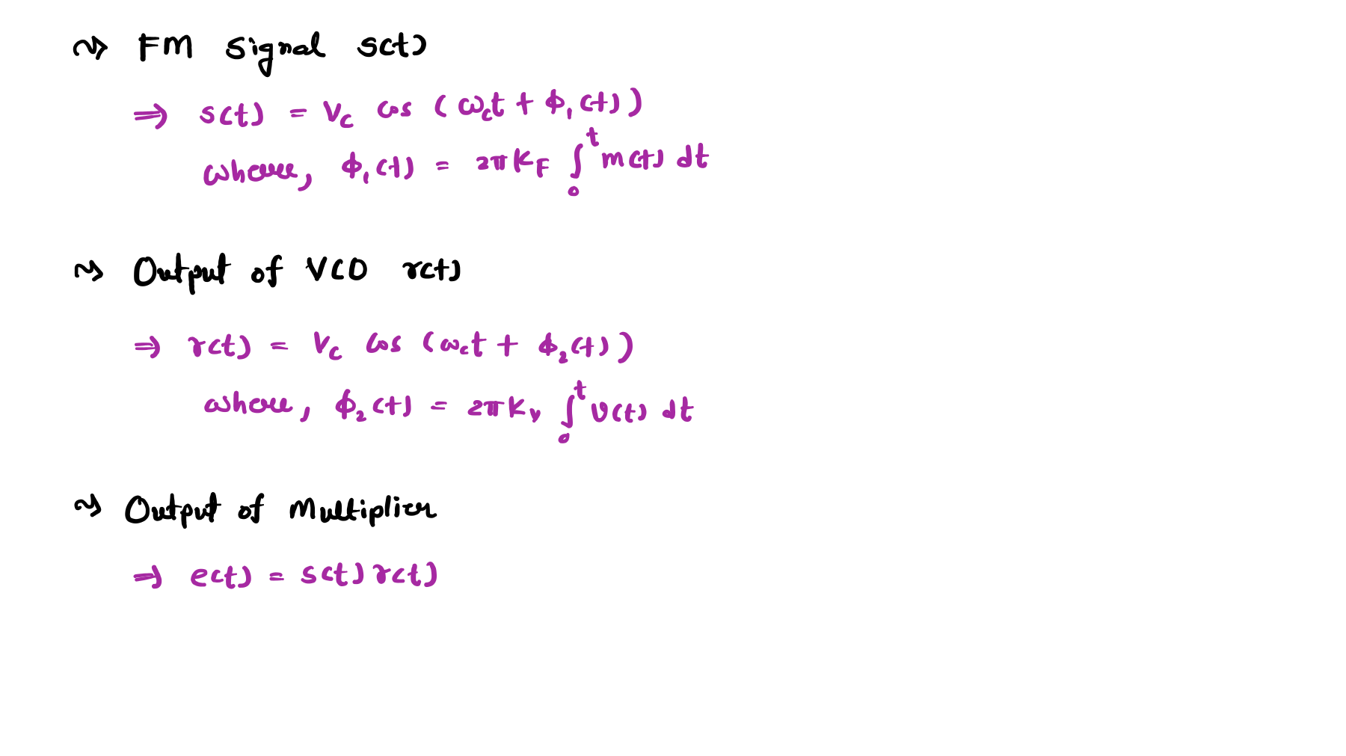

Slide 37
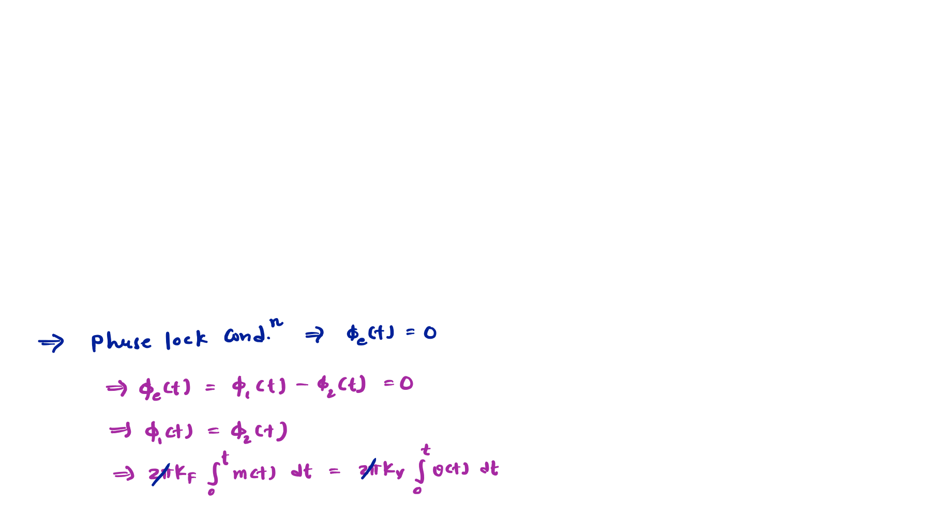




Linear Model of Phase Lock Loop
𝟐𝛑𝐤_{𝟎}
𝟏/𝟐𝛑𝐤_{𝐕}
𝚽_{𝐞} 𝐭
𝐡 𝐭
∑
_
𝚽_{𝟏} 𝐭
𝐯 𝐭
𝚽_{𝟐} 𝐭
𝐭
න 𝐝𝐭
𝟎

Slide 38
